Slide 1
The constraints led approach
August 2020

Slide 2
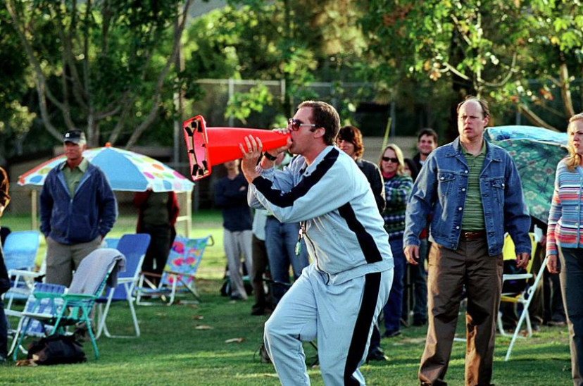
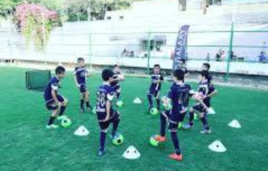
The traditional coach-centred model
All knowledge rests with the coach.
Coach knowledge is imparted to the player.
There is a right and wrong way which must be explicitly taught.
Coach is the solution provider.
Skills may be taught in isolation (drills).
Skills can be acquired by verbal direction.
Teaching is learning.

Slide 3
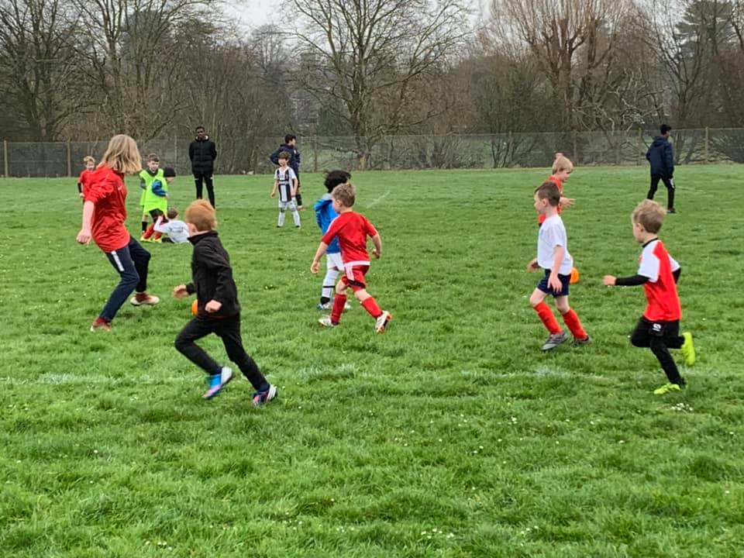
The player or child-centred model
Knowledge of the person is your guide.
The person is at the centre of the experience.
What works is what works for the person.
Decision-making in context is critical.
Coach is the learning environment designer.
Coach is an observer and questioner.
Skills are acquired in context. Learning can be implicit.

Slide 5
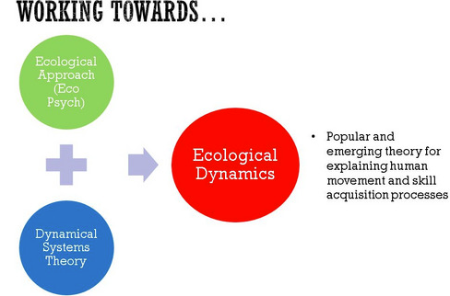
Constraints led approach
In addition to free play, we use the constraints-led approach (CLA) to design games.
CLA is based on a skill acquisition theory called ecological dynamics. It recognises that learning is non-linear …. it doesn’t go in a straight line.
This can get pretty complex but essentially the theory recognises that humans function within the context of their environment.
Football is a highly dynamic, complex environment.
The person-environment interaction is at the core of the learning process.

Slide 6
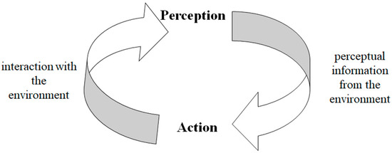
Perception-action coupling
You perceive, you act, you perceive, you act………..
A key part of the theory is to recognises that the person and environment are continuously influencing each other to shape action.
Traditional coaching theory has centred on external methods of helping players respond to the environment e.g. verbal instruction/feedback.
CLA prioritises self-organisation, noting that a person’ actions, perceptions, intentions, emotions and the environment are deeply intertwined and internalised.
The possibilities for action that we perceive in our environment are called ‘affordances’. The CLA aims to help players recognise affordances.

Slide 8
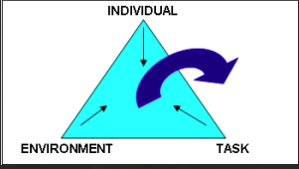
Using constraints
Creating opportunities to act
The idea of placing constraints in a game is to provide opportunities (affordances) to perceive and act not to restrict play.
Constraints are broken into three:
❑ Individual - e.g. height, confidence, experience, psychological. Our ‘form of life’.
❑ Environmental – e.g. weather, size of pitch, time of day.
❑ Task - e.g. number of players, goals, size of balls.
By manipulating the constraints, we can provide opportunities to perceive and to act.

Slide 9
Environmental and individual constraints…. form of life

Slide 10
What is the coach’s role?
“The gardener cannot actually “grow” tomatoes, squash, or beans – she can only foster an environment in which the plants do so.”
Observes game dynamic to inform questioning
Co-creator and designer – deliver with and not to
Values what kids want
Flexible and adaptive
Facilitative not directive

Slide 11
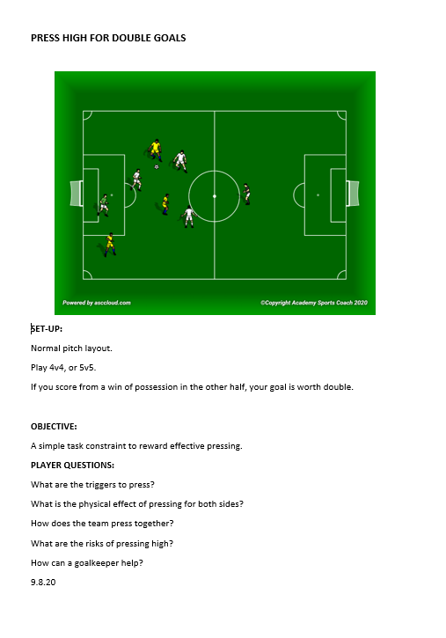
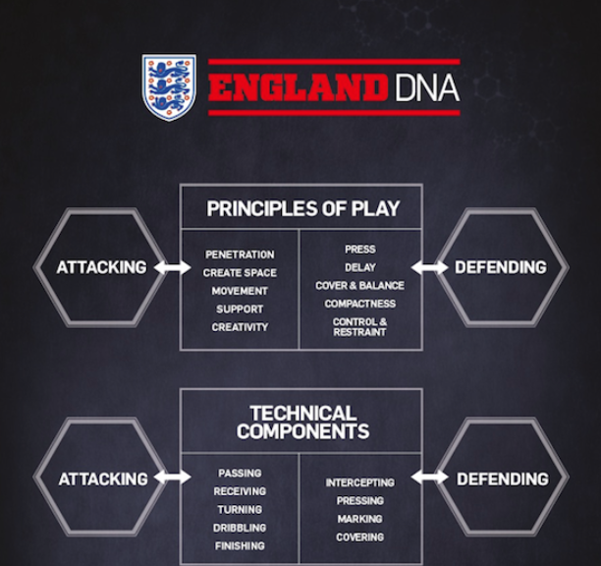
How does this look in practice?
A checklist!
There are four basic things to consider in CLA design (Renshaw et al):
session intention (remember to make it age appropriate);
the constraints to be imposed and the affordances they might create;
representative learning design (is it game realistic?); and
repetition without repetition (the idea you can practice something like dribbling in a variable way).
There are trade-offs. We can over-constrain. For example, the more repetition we create, the more game realism we might lose. Kids in unopposed zones, boxes, two touch only etc.

Slide 12
Confused? Don’t worry, start simple…….!
AIK have worked out these simple principles to build from.
Remember:
FUN!
SIMPLICITY is key. The COMPLEXITY should lie in the playing of the game.
Allow players to solve problems autonomously.
Coaches should OBSERVE, OBSERVE AND OBSERVE SOME MORE!!
Practice open questioning to draw attention to relevant affordances in the game. Questioning should not be disguised direction!

Slide 13
From the ball court to the performance environment

Slide 14
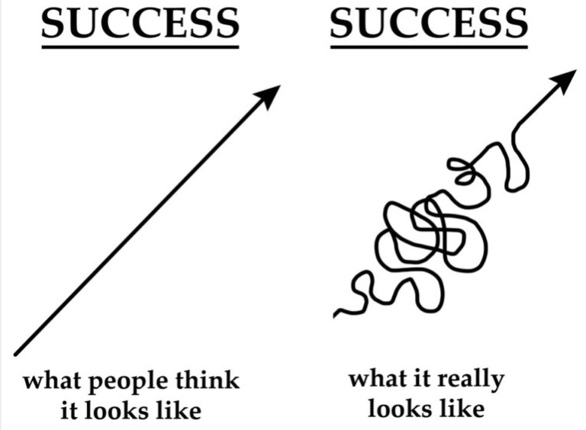
And remember……….!

